Slide 1


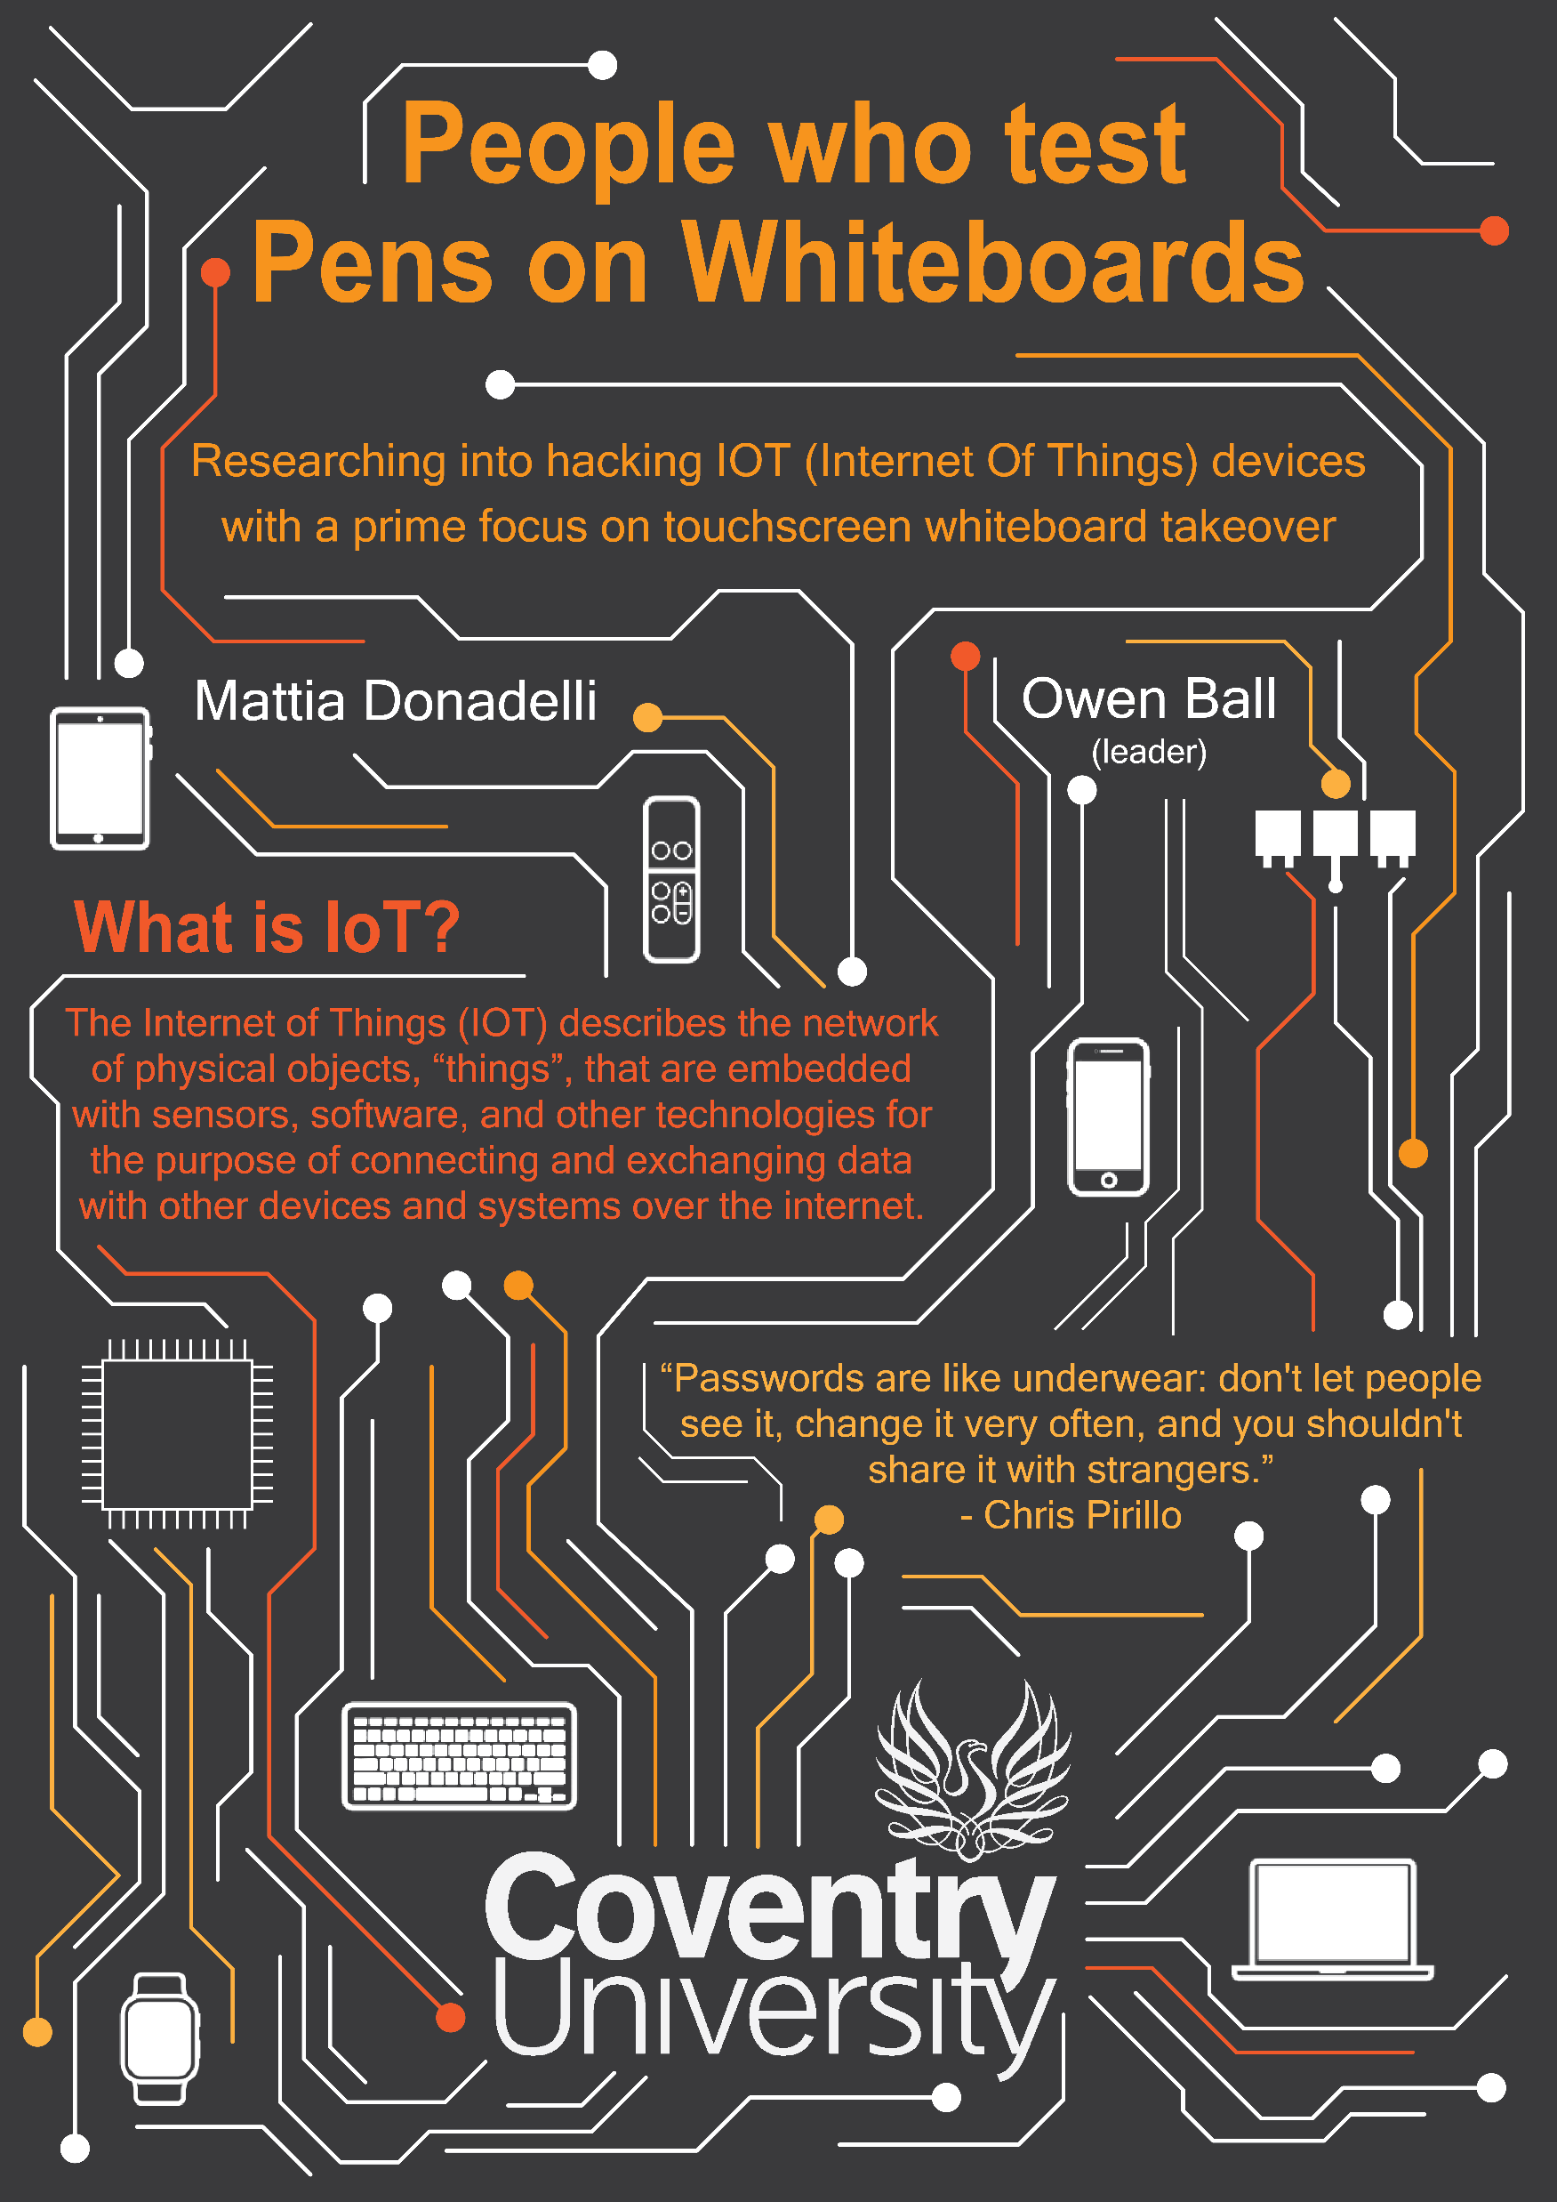



People who test Pens on Whiteboards -Whiteboard Hacking

Slide 3
What are the main stages to exploiting a IOT device
Researching/Reconnaissance
Scanning
Exploiting
Post Exploitation

Slide 4
Research/Reconnaissance

Slide 5
Questions we need to ask and find out
What model and version are we working on?
# Version: 2.5.0719.1034
# Tested on: ViaWare Go (Windows 10)
Do we need permission to attempt any type of attack and if so, how?
Yes, as this is university property, we need to ask permission. This led to the team asking permission to attempt this exploit in the hacking lab (separate to the rest of the university)
Can we reach the whiteboard via the internet?
Yes and No, as you can choose to connect the KIA to the internet but for security reasons the university disabled this.
Is the model and version the same for all the screens and rooms in the building?
Yes and No, due to single smaller screens having the KIA Go whereas the big touchscreen whiteboards used a different architecture to mirror one shared screen throughout the room. This is the same throughout all rooms checked in the university
Are the whiteboards connected to the same network as the students?
Yes, if we can show our screen then we presume we are.
How do we communicate with devices if no internet is available then?
Port 9982 is open (Telnet) which we guess is how the whiteboard and client communicate. This also tells us only people connected to the network can communicate with the device
Do any CVEs exist already with possible exploits?
Yes, they do
# CVE : CVE-2019-17124, CVE-2021-36356

Slide 6

Scanning
Statement
This is a vital part of the research/reconnaissance process, but because this is on university property which includes student’s professors' visitors etc., we could not perform this step as we don’t have the legal rights or this not being an official penetration test
What can we do?
Go into lecture halls, study rooms etc (which we have permission) and have a look ourselves at IP address’, if KIA’s was installed on the whiteboards e.g. physically looking.
We can also ping these Ip address’ from computers to see if we can communicate with them
Try and connect through telnet via Putty and port 9882 (successful)

Slide 7
VIA Connect Pro
Settings we could change
Update Firmware
Upload arbitrary Wallpaper image
Create/Edit/Remove users
Edit the Wi-Fi configuration
Edit the gateway Id, sever Ip config
Reset Logs
Settings we could only see:
Whiteboard model
See the system logs
See the Ip address and gateway configuration (from which we realized that the whiteboard wasn’t on the same network as any of the lab nor the internal campus network)
Power, Display and Cloud Settings
View Apache certificates (not password protected)

Slide 8
Exploitation

Slide 9
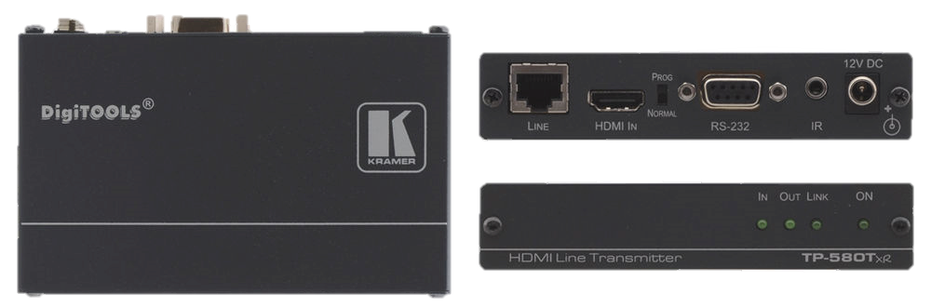
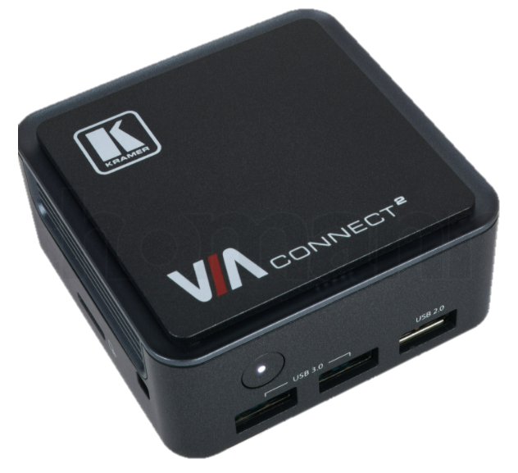
Physical attempts and manoeuvres
- We tried to plug a keyboard on the side of the monitor itself, thanks to the reboot telnet command (see slide 2) we noticed that the keyboard got power but wasn’t being registered so, after messing around a bit more, we found the VIA controller on which there was 1 free USB port. We plugged the keyboard in and * insert keyboard smashing story *
We checked the Ip addresses of the computers outside the lab, inside the lab, and inside other rooms in order to compare the Ip addresses (here we figured that the whiteboard had an own network)
We also compared other whiteboard’s Ip addresses and found out that they share the same network

Slide 10
Telnet – What we tried to do
Reboot: 6/10: the command allows to reboot the whiteboard, it was really useful when we tried the physical approach since the BIOS info stated whether there was a keyboard connected
Launch 10/10: the command allows to specify an URL the whiteboard will open IE and try to connect to the specified URL. Here we realized that the whiteboard couldn’t connect to the internet. We also tried to boot MS Paint to try to gain RCE (CVE-2010-0028) but it wasn’t installed.
WIFI Guest Mode 8/10: the command would allow the user to remotely setup the guest mode on Wi-Fi which would have allowed us to connect and be on the same network as the whiteboard. Unfortunately, the command isn’t available on this model of whiteboard.

Slide 11
Exploitation- Remote
In the VIA Management setting’s, we can locate whiteboard which let’s us via files
After realising we could access the PHP browser page “browseSystemFiles.php?path=*anything*” via the settings. We realised that we could openly look at the files installed.

Slide 12
Exploitation- Remote
We also noticed notepad.exe was installed which was are possible foothold
Looking into the source code, you can see a hidden field “associateFileName”. Manipulating this to an address on the system (which we can openly look for) and adding some code to the notepad.exe (source code) we can actively download files with a chosen extension on the machine
After creating a file with “.cmd” extension, we can execute commands which if connected to the internet could of created a reverse shell
We tested this with the file path “C:/httpd/cgi-bin/exploit.cmd” with the command “echo test” in the notepad.exe
Navigating to the chosen address in this case “C:/httpd/cgi-bin/exploit.cmd” in the browser https://ip/cgi-bin/exploit the command was executed

Slide 13
Exploitation- Remote
Navigating to the chosen address in this case “C:/httpd/cgi-bin/exploit.cmd” in the browser https://ip/cgi-bin/exploit the command was executed

Slide 14
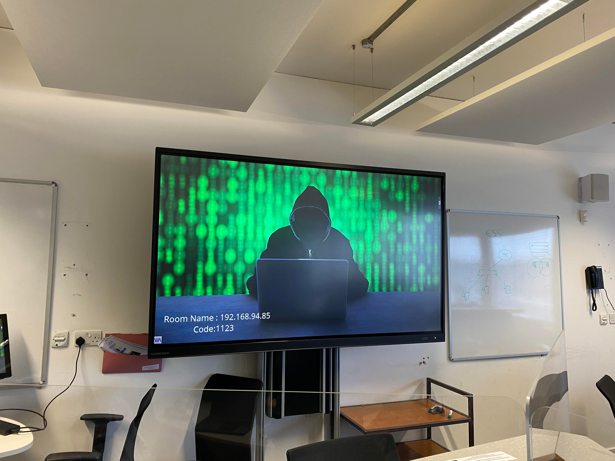
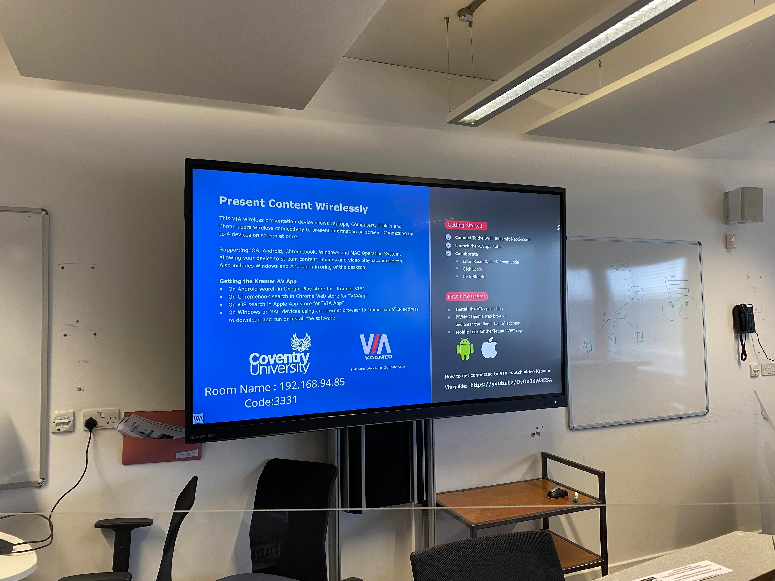
Automated Exploitation
We wrote this into an exploit using python 3 and burp suite requests that allows us to save commands into a file and show the output by navigating to the file via python libraries.
Shown below is the brief description

Slide 15
LIVE pre-demo
At 8:30 this morning we arrived at the event
After setting up the whiteboard we realised that EC1-29 (this room) doesn’t have the same whiteboard technology as every other room in ECB
Problem
We then took the Via Kramer Go device out of the hacking lab (with permission) and connected it to the whiteboard
Second problem BIG problem
We found out that the Via Kramer Go runs in Linux and is set up completely differently to the big whiteboards in the other rooms
After lots of quick and I mean quick research, we managed to get a shell and then privilege escalate (root/administrator user) and automate another script but are limited to the number of things we can achieve as now on a limited time

Slide 16
Demo

Slide 17

Post Exploitation
This step would allow us to gain a future backdoor into the device by adding exploits such as malware, root kits and trojans but as we didn’t need this step and aren’t wanting to do anything malicious, we didn’t attempt this part of the pen testing process.

Slide 18

Q & A – Thanks for listening ☺

